Slide 1
Predictive Modelling for COVID-19
in Public Health
Capstone Project for the end of 3MTT Program Cohort 2
Data Science
OYEWALE ROFIAT TITILAYO
ALC Learning Centre: SQI College at Challenge, Ibadan, Oyo Sate.

Slide 2
Agenda
Introduction
Data Exploration
Model Development
Conclusion

Slide 3
Introduction
Outline Problems
The COVID-19 pandemic has posed significant challenges for public health organizations in predicting virus spread and understanding the factors that impact transmission and patient outcomes.
The organization requires actionable insights to inform policies, anticipate future outbreaks, and improve health resource allocation.
Using historical COVID-19 data, to conduct data cleaning, perform exploratory data analysis (EDA), and develop predictive models to forecast COVID-19 trends.
Contents of Data Analysis
Recorded Cases by WHO Region
COVID-19 Trend Overtime
Top 10 Countries with highest Daily growth rate and mortality ratio cases
Global Distribution of COVID-19 Cases
Countries with most Death and Active
Mortality ratio by WHO Region
RFM Analysis and customer classification

Slide 4
Data Exploration
The original Data came from COVID-19 Open Research Dataset (CORD-19) on Kaggle, https://www.kaggle.com/datasets/allen-institute-for-ai/CORD-19-research-challenge/data
The Dataset used contain 35156 rows and 10 columns
Here's the Dataset Dictionary:
Date: Date of observation (string format).
Country/Region: Name of the country or region.
Confirmed: Cumulative confirmed cases.
Deaths: Cumulative deaths.
Recovered: Cumulative recovered cases.
Active: Current active cases.
New cases: New cases on a given date.
New deaths: New deaths on a given date.
New recovered: New recoveries on a given date.
WHO Region: WHO-designated region.
Data Quality Assessment and ‘Clean Up’
Key Issues for Data Quality Assessment
Accuracy: Correct Values
Completeness: Data fields with Values(No Missing Value)
Consistency: Values free from Contradiction
Currency: Values up to Date
Relevancy: Data items with Values Mete-data
Validity: Data containing Allowable Values
Derived variable: Active, Month and Death Ratio Column

Slide 5
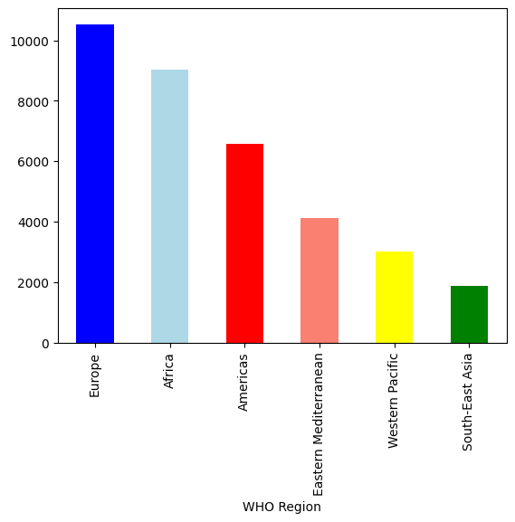
Data Exploration
Recorded Cases by WHO Region
There were 187 countries recorded cases while each country have 187 days recorded case from the month of January 2020 to July 2020.
6 WHO Region were recorded in the data and Europe had the highest recorded cases followed by Africa, America, Eastern Mediterranean, Western Pacific while South-East Asia had the lowest recorded cases.
Monthly Recorded Cases by WHO Region
WHO Region | Africa | Americas | Eastern Mediterranean | Europe | South-East Asia | Western Pacific
Month-str
Apr | 1440 | 1050 | 660 | 1680 | 300 | 480
Feb | 1392 | 1015 | 638 | 1624 | 290 | 464
Jan | 480 | 350 | 220 | 560 | 100 | 160
Jul | 1296 | 945 | 594 | 1512 | 270 | 432
Jun | 1440 | 1050 | 660 | 1680 | 300 | 480
Mar | 1488 | 1085 | 682 | 1736 | 310 | 496
May | 1488 | 1085 | 682 | 1736 | 310 | 496

Slide 6
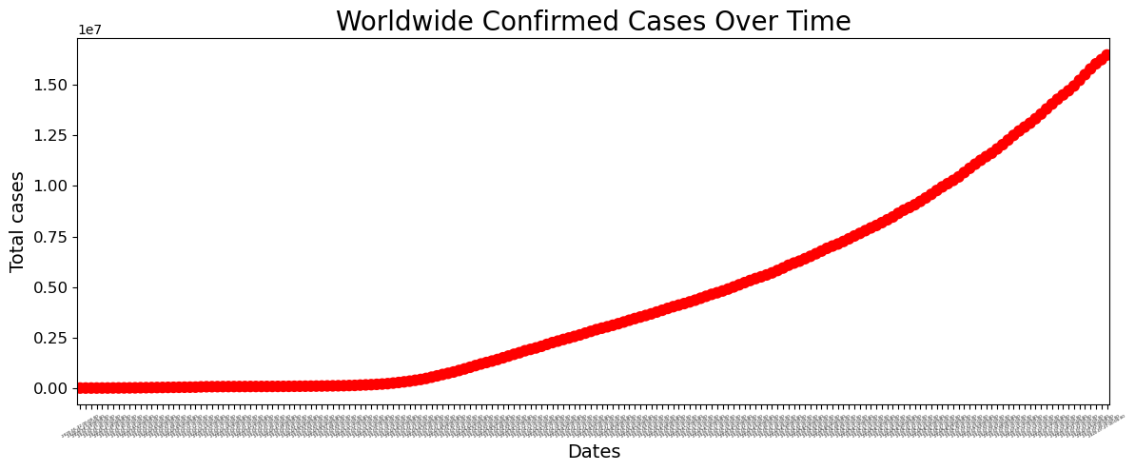
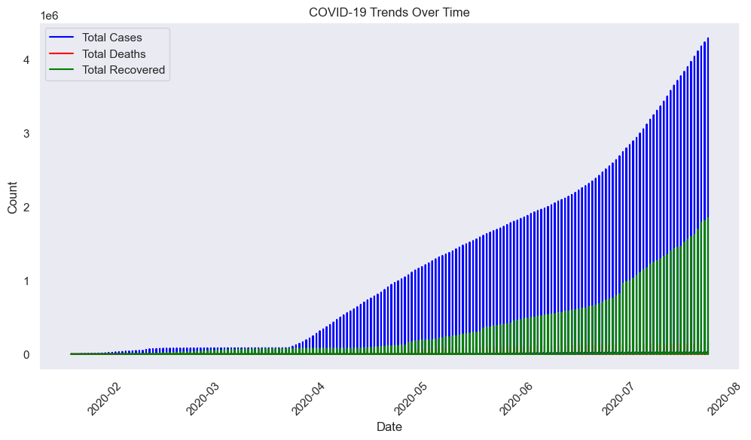
Data Exploration
Global Trends of COVID-19 cases over time
Confirmed COVID-19 cases over time shows an exponential increase, with the number of cases rising steadily as the pandemic progresses.
Deaths, and recoveries over time from February 2020 to August 2020. The blue bars represent the total number of cases, which show a steady exponential increase. The green section represents recoveries, which also increase but at a slower pace compared to total cases. The red line, indicating deaths, grows steadily but remains significantly lower than recoveries and cases.
Overall, the data highlights the rapid and continuous spread of the virus worldwide, emphasizing the scale and urgency of the global health crisis, with recoveries improving over time, though the burden of total cases continues to escalate.

Slide 7
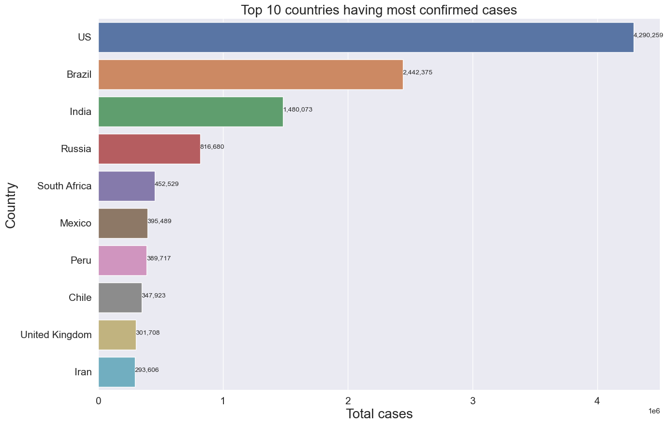
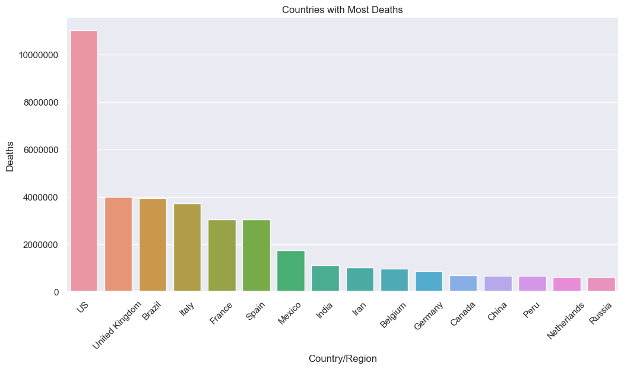
Data Exploration
COVID-19 impact across the top 10 Countries by Daily Growth rate and Mortality rate.
The United States, Brazil, and India show the highest daily case growth, while countries like Mexico and the United Kingdom exhibit high mortality rates relative to their case counts.
The cumulative deaths chart highlights the U.S. as the most severely impacted, followed by Brazil, India, and Mexico.
These trends reveal significant disparities in the pandemic's progression and severity, shaped by healthcare infrastructure, response measures, and demographic factors.

Slide 8
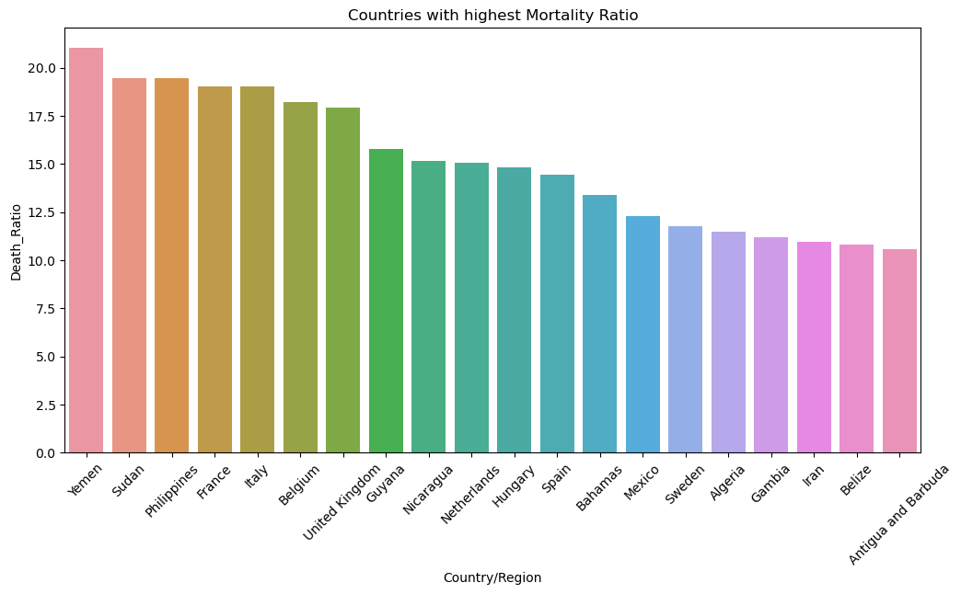
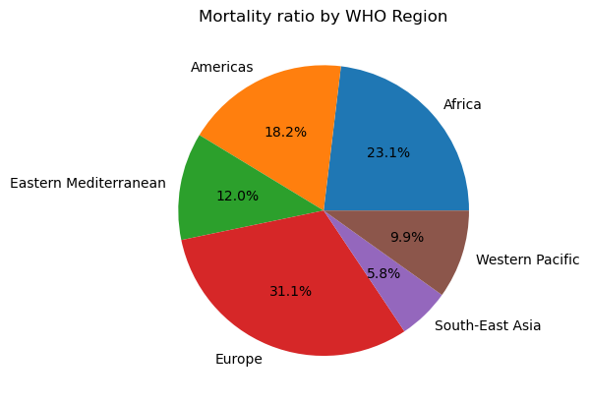
Data Exploration
Mortality Ratio Distribution

Slide 9
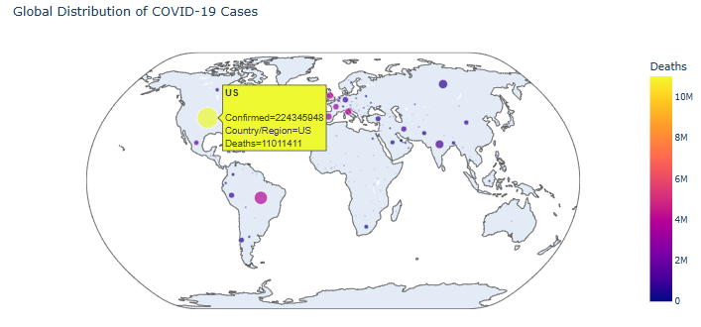
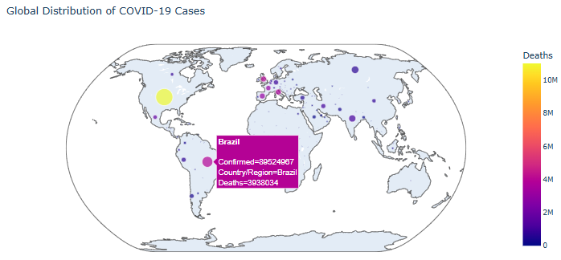
Data Exploration
Global Distribution of COVID-19 Casaes
"Taking a deeper look of France data, from the observation, US, Brazil have her confirm case, death rate and recovery, but lower Death Ratio, Only France is the observe country with high confirm cases, death rate, death ratio and lower recovery rate"

Slide 10
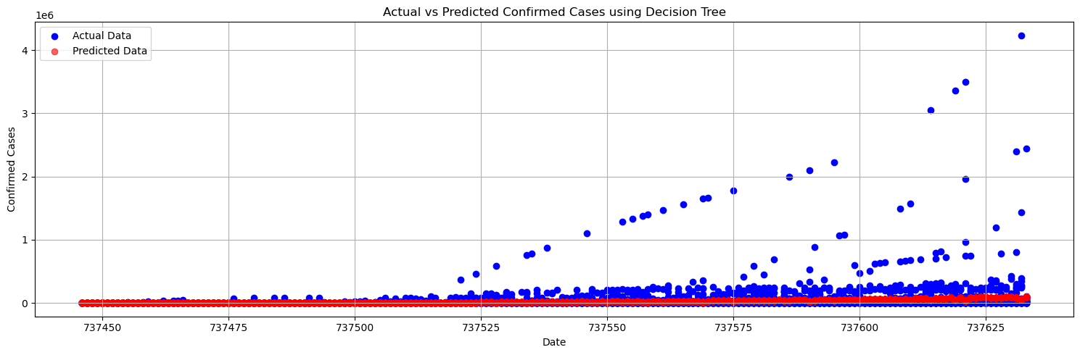
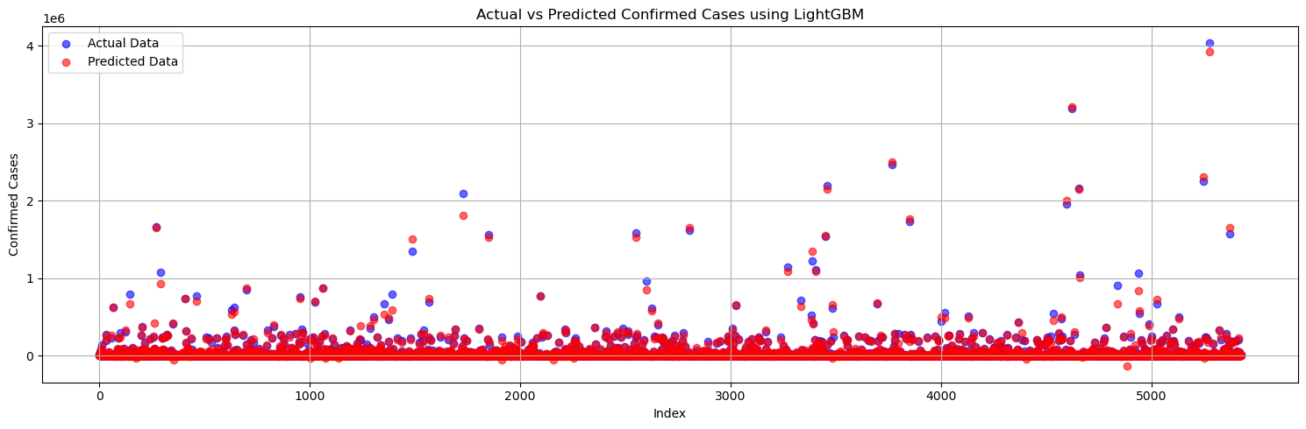
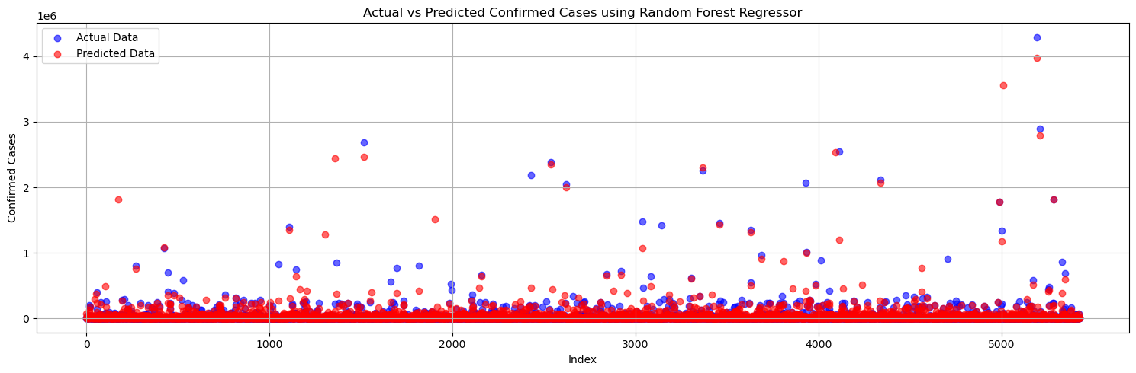
Model Development
Comparing Model's Predictions to the Actual Values for Confirmed Cases.
This Plot Helps Highlight How Well The Model Follows Trends And Where Deviations Occur.
Observations:
The Blue Line Represents The Actual Values.
The Orange Dashed Line Represents The Predicted Values.

Slide 11
Model Development
Insight for Confirmed Cases using Gradient Boosting Model (LightGBM)
The R-squared (R²) value of 0.992 indicates that the LightGBM model explains 99.2% of the variance in the target variable, showcasing an excellent fit.
Despite the strong fit, the MAE (3125.73) and RMSE (12774.68) suggest significant prediction errors, particularly for larger deviations.
Actual vs Predicted Data using LightGBM: shows that the predicted values (red points) closely align with the actual values (blue points), demonstrating good model performance across most data points. However, there are visible deviations in some regions, especially with larger values, suggesting potential challenges with extreme cases.

Slide 12
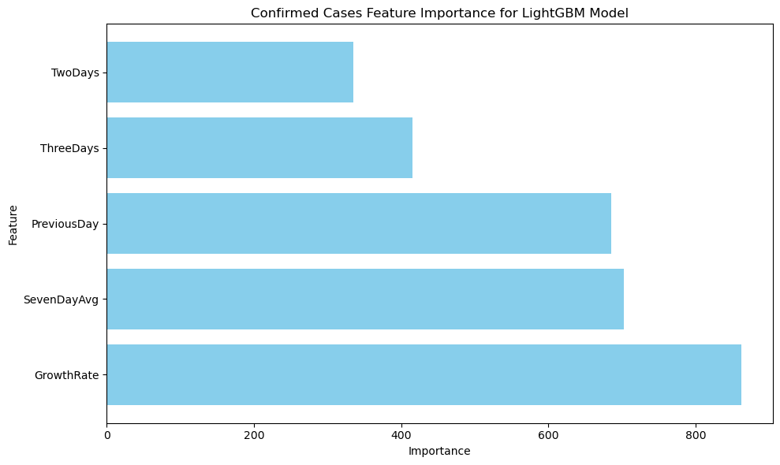
Model Development
Insight for Confirmed Cases using Gradient Boosting Model (LightGBM)
Feature Importance for LightGBM: Highlights that "GrowthRate" is the most influential feature, followed by "SevenDayAvg" and "PreviousDay," indicating that recent trends and growth rates are critical for predictions. Meanwhile, "TwoDays" and "ThreeDays" have less importance, showing lower contributions to the model's overall performance.
Gradient Boosting Model (LightGBM)
While the model performs exceptionally well in explaining variance, the high error metrics suggest potential overfitting or the need for adjustments in handling outliers or extreme values.

Slide 13
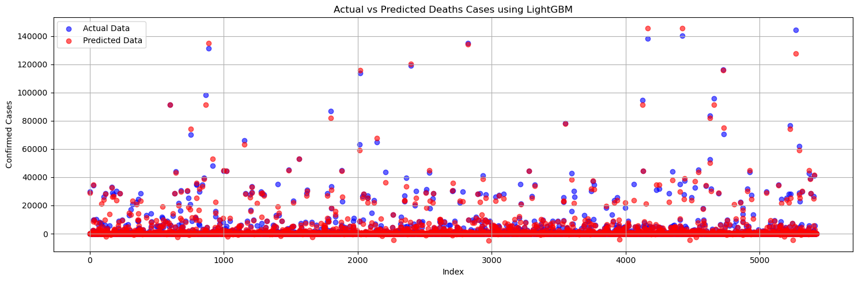
Model Development
Insight for Death Cases using Gradient Boosting Model (LightGBM)
The R-squared (R²) value of 0.981 indicates that the model explains 98.1% of the variance in the target variable, showcasing an excellent fit and predictive performance.
The MAE (317.08) and RMSE (1122.74) are significantly lower compared to the previous model, reflecting improved accuracy and smaller prediction errors.

Slide 14
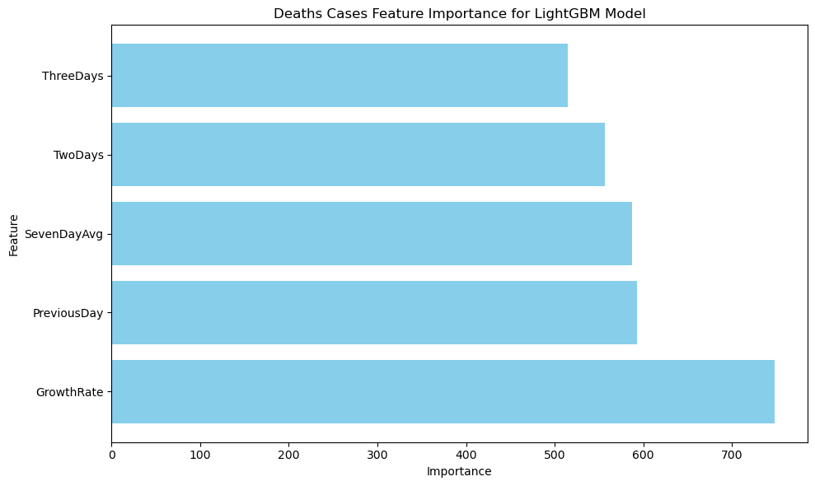
Model Development
Insight for Death Cases using Gradient Boosting Model (LightGBM)
Feature Importance for LightGBM: Highlights "GrowthRate" as the most influential feature (748), followed closely by "PreviousDay" (593) and "SevenDayAvg" (587).
This suggests that recent trends (e.g., growth rate and averages over seven days) are critical for making accurate predictions, while "ThreeDays" (515) is less impactful compared to other features in this model.
Overall, the model is highly reliable, with reduced error metrics and a more balanced feature contribution, indicating a well-optimized setup for the given dataset.

Slide 15
Conclusion
The data reveals global COVID-19 trends, highlighting significant disparities in case growth and mortality rates across countries. Several environmental factors contribute to the spread and severity of the virus:
Population Density: Crowded areas facilitate close contact, increasing the risk of transmission.
Climate and Weather: Cooler, less humid climates may prolong virus survival, while warmer, humid conditions could slightly reduce its spread.
Urbanization: High mobility and interconnectivity in urban areas accelerate the spread of the virus.
Air Quality: Poor air quality and high pollution levels exacerbate respiratory issues, increasing the severity of COVID-19 cases.
Healthcare Infrastructure: Limited access to healthcare services, clean water, and proper sanitation hampers containment and treatment efforts.
These environmental factors, combined with social behaviors such as mask-wearing and physical distancing, play a crucial role in shaping the pandemic's impact across different regions.
Project Code link:
https://github.com/OluwaseunPhronesis/3MTT-Capstone-Project/blob/main/3MTT%20CAPSTONE%20PROJECT.ipynb

